Slide 1
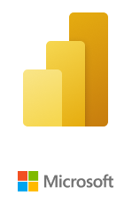
Understand all about - Power BI Desktop(UI)
By Sandeep Raturi

Slide 2
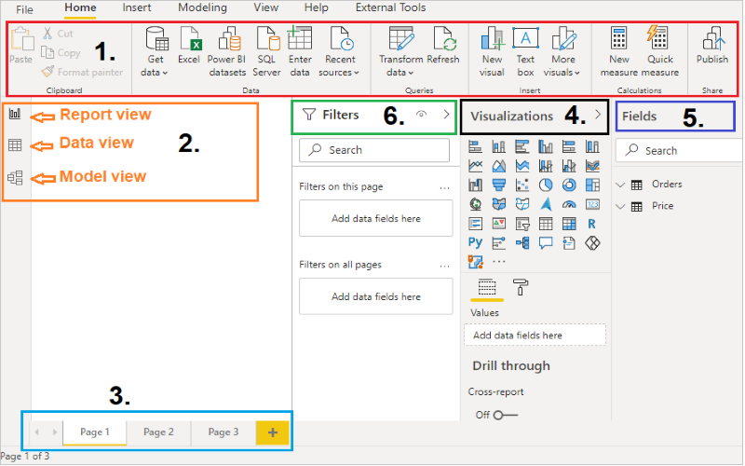
Topics to be cover here-
1- Ribbon Bar
2- Views
3- Pages Tab
4- Visualization Pane
5- Fields Pane
6- Filters Pane
7- Search Bar

Slide 3
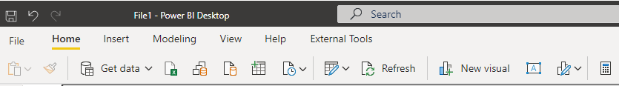
1- Ribbon Bar
It displays common tasks like- Get data, Transform data, Add new visuals, Publish report etc. and that are associated with reports and visualizations.

Slide 4
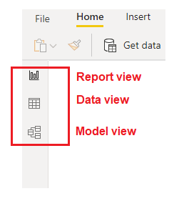
2- Views in Power BI
There are three types of views in Power BI-
Report or Canvas view: Allows you to create & view the visualizations.
Data view: You can see your all report data here, and you can quickly validate your data.
Model view : Shows all of the tables, columns, and relationships in your
model and you can set and mange the relationship between tables.

Slide 5
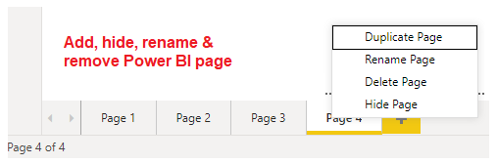
3- Pages Tab
You can find this bottom of the page, allows you to add, select, remove & hide the report page, also you can create a duplicate report page from here.

Slide 6
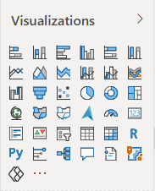
4- Visualization Pane
Provides you 30+ visuals, where you can change visualizations, customize colors or axes, apply filters, drag fields, and more.

Slide 7
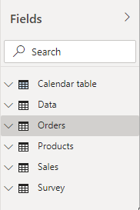
5- Fields Pane
It displays the tables, folders, and fields in your data that are available for you to use to create visualizations.

Slide 8
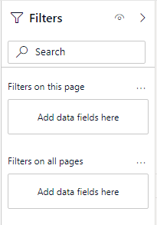
6- Filters Pane
Filter pane types-
Visual level filters: This is visual level filter and applied directly on individual visualizations. Such filters are applied both on data and calculation conditions used within a visualization.
Page level filters: This filters are used to filter the visuals present in the page.
Report level filters: The report-level filters are the filters that you use to apply a
filter condition on the entire report.

Slide 9
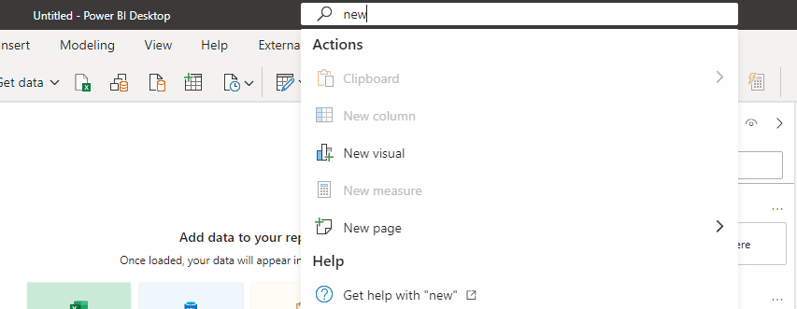
7- Search bar
In Power BI February 2021 updates, Power BI has released Search bar feature in Power BI Desktop.
Sometimes its difficult to find the commands, files, or options in Power BI Ribbon but with this Search bar, you can search easily just like other Office products.

